Slide 1

Peer-to-Peer Loan Default Prediction Using Historical Loan Data
Edward Chang – Data Scientist

Slide 2
Table of Contents
Background
Problem Statement
Data
Initial Risks and Challenges
Modeling
Conclusions
Further Improvements

Slide 3


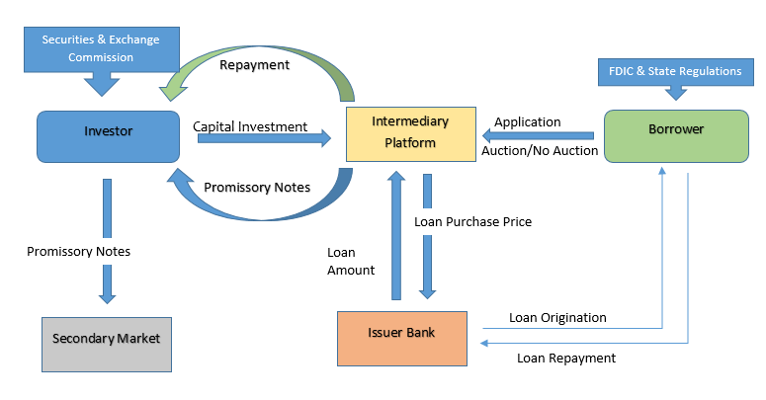
Background
What is peer-to-peer (‘P2P’) lending?
P2P lending platforms offer advantages for both parties, lenders and borrowers.
The market volume of peer-to-peer (‘P2P’ ) lending has rapidly grown in the past few years and is continuing to grow with consumer P2P loan originations reaching $93.5 bn in 2020.
Studies have shown banks increase credit for consumers who obtain P2P loans.
Notes:
Audience: P2P Platform investors and developers
Prosper, Lending Club
P2P Lending: sort of like crowd funding, private borrowers get microloans they can use for different purposes. Investors select these unsecured loans on the basis of borrower characteristics and loan details and lend a portion of the amount
Borrowers pay back generally in a monthly payment structure, or can even pay back earlier. Investors profit on interest rate tacked onto borrowed funds
It is seen as an alternative, that is more convenient, faster, and cheaper to banks due to online presence, automation, and favorable regulation
It fills a gap for microloans starting at low amounts with comparably lower interest rates
Loan Origination: Process where borrower applies for a loan and lender processes the application – aka loan app to disbursal of funds
Pricewaterhouse Coopers (PWC) expects P2p to grow to 150 billion by 2025
Advantages:
Easy access, online and can be funded quickly – lack of documentation needed
Interest rates can be lower and therefore more attractive for borrowers
Lower screening costs due to algoirthms that underwrite loans
Study by Tetyana Balyuk in 2019 found that banks are prone to increasing credit lines for customers who get p2p loans, especially those with inferior credit histories – generally borrowoers use p2p loans to refinance bank debt.
Information spillover and the tendency to refinance debt generally leads to larger lines of credit
FinTech innovations in lending can mitigate credit market imperfections by relieving information frictions for consumers and generating information spillovers to traditional credit intermediaries such as banks

Slide 4
Problem Statement
P2P Lending is inherently more risky than traditional lending through banks.
Lack of collateral
High default risk is present due to information asymmetry between the investor and borrower.
This study aims to train several machine learning models to predict if a borrower will pay a loan in full or default using financial and credit-related information available to the investor.
By having an effective model, we can reduce rents paid by the investor , mitigate losses due to default, and overall make P2P lending platforms an attractive and effective vehicle for borrowers and investors alike.
Notes:
With the risk in this growing space, it is imperative to have a robust credit risk model or one that can help predict potential charge-offs to reduce platform rent (money spent on collection efforts and legal fees)
Information Asymmetry: Lenders have naturally less available information and data about the credibility of the borrower. Borrowers also have more information in regards to the return and their investment projects. Borrowers can observe actual returns from productions, without cost.
Loan defaults are unfavorable to the profits of investors and the development of effective p2p lending platforms

Slide 5
Data
Source: Lending Club, hosted on Kaggle
Accepted Loans from 2007 - 2018
Initial Size: 2.26 mil with 151 features
Final Size: 1.31 mil with 23 features
Variables | Variable Type | Data Type
loan_amt, term, int_rate, installment, dti, delinq_2yrs, inq_last_6mths, open_acc, total_acc, pub_rec, revol_bal, revol_util, avg_cur_bal, pub_rec_bankruptcies, tax_liens, mort_acc, credit_file_age, fico, log_annual_inc | Independent | Numerical
emp_length, purpose, home_ownership | Independent | Categorical
loan_status | Dependent | Categorical
Notes:
Lending Club has been used for numerous areas of studies, mainly within this P2P space due to its large historical dataset that is open-source
It is only up until 2018 as they stopped hosting their dataset and did not include FICO scores for loan applications in future datasets

Slide 6
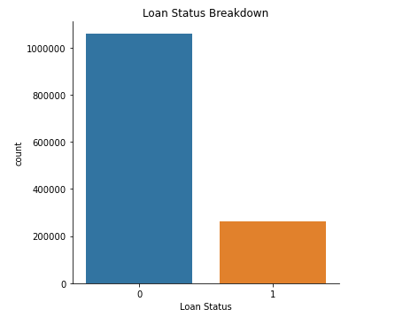
Initial Risks and Challenges
Imbalanced classes
Ratio of 80:20
Accuracy Paradox
Large data set
Training Times
Loan data subject to outside factors
Health of the economy
Notes:
Accuracy Paradox – when accuracy is not a good metric for predictive models when classifying predictive analytics.
Use Area Under the Curve – Receiver Operating Characteristics Curve AUC-ROC and PR-AUC ROC Score for evaluation metric to have a more effective model. We want to minimize the number of false negatives or maximize the recall score (sensitivity)
The higher the AUC, the better the performance of the model at distinguishing between positive and negative classes
Precision Recall ROC is great for dealing with imbalanced classes since they are focused on the positive class (the minority class) and unconcerned with true negatives. We want to minimize the number of false negatives – aka we want to have the least number of wrongfully predicted charge-offs/defaults
Large Data Set:
-Selective models, didn’t run on all available
-Logistic Regression, Random Forest, KNN, Deep Learning Model
Economic Factors:
In an economic slowdown, lenders can become more risk averse and decline loans they would have accepted in other times
An economic slowdown could reduce the risk-adjusted profitable opportunities for small businesses to invest , reducing demand for loans

Slide 7
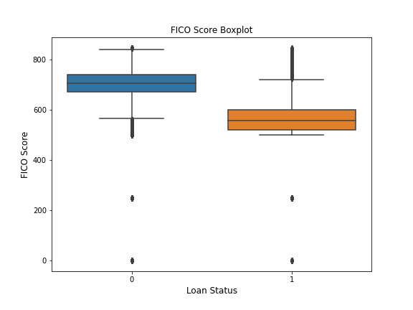
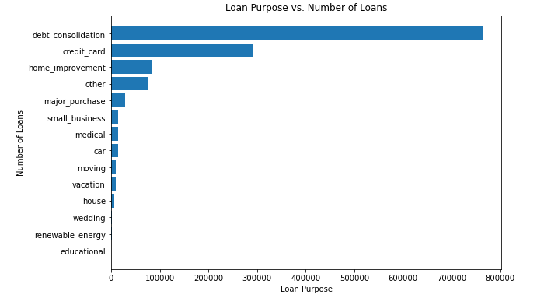
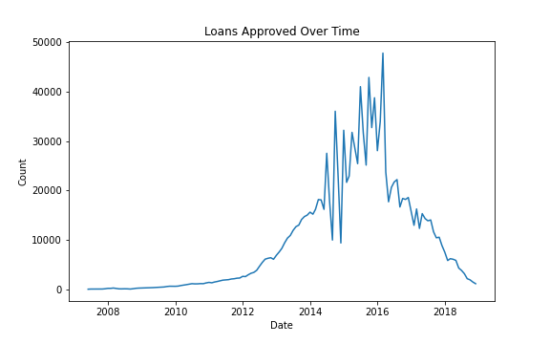
Data Visualizations
Notes:
As we can see the most common purpose for a loan is for debt consolidation, with credit card trailing behind by a large margin – it shows most individuals only really get microloans to refinance their debts, or refinance their credit cards. Wanted to pull this up in conjunction with the information talked in background – as it shows many people may benefit from getting these P2P loans – especially in a debt trap, it helps get these people out of a rut
Many other purposes had very very low counts and were simplified to be grouped together (debt consolidation, credit card, home improvement, major purchase, small business, medical, other)
Lower FICO score associated with potential to default, outliers seen in lower bounds, had to be removed – FICO ends up being a very important feature
IPO in 2014, largest tech IPO of 2014 – decline may be due to negative public perception of Lending Club. Issue with internal auditor. Most loans are between 2014 and a bit past 2016, dearth of loan information from prior to 2012, specifically at 0 and 220

Slide 8
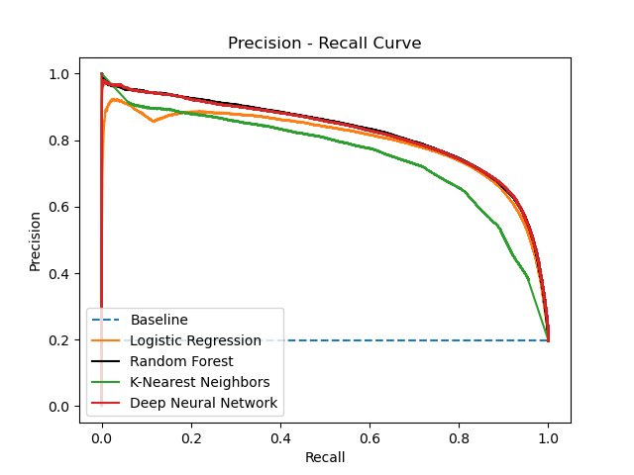
Modeling
Models Selected:
Logistic Regression
Random Forest
K-Nearest Neighbors Classifier
Deep Neural Network
Notes:
Logistic Regression- Linear Algorithm
K-Nearest Neighbors – Nonlinear Algorithms
Random Forest – Ensemble Algorithm
Deep Neural Network – artificial neural network with multiple layers

Slide 9
Modeling: Evaluation
 | Recall | Precision | AUC-ROC | PRC-AUC | Accuracy
Random Forest | 0.7725 | 0.7613 | 0.95 | 0.825 | 0.9067
Logistic Regression | 0.6854 | 0.7912 | 0.947 | 0.7968 | 0.9015
KNN Classifier | 0.5634 | 0.7861 | 0.9151 | 0.7567 | 0.8828
Deep Neural Net | 0.7738 | 0.7596 | 0.9506 | 0.8233 | 0.9064
Notes:
Baseline PR-AUC: 0.277, ROC-AUC: 0.499, Recall: 0.197, Precision: 0.197, Accuracy 0.6835
-Dummy Classifier, simulates guessing on the basis of distribution of classes
It has the highest PRC-AUC score, although it is only slightly higher than that of the Deep Neural Net
In addition to this, it had the highest testing data accuracy score

Slide 10
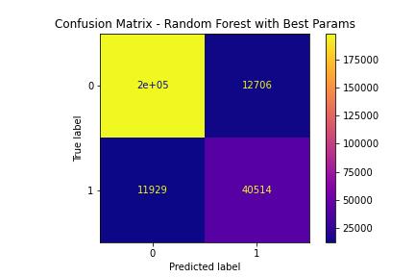
Conclusion & Insights
Random Forest model performed the best based upon PR-AUC score and accuracy score
Without institution assigned credit grade
Most Important Features:
FICO Score
Interest Rate
Debt-to-income ratio
Installment Size
Average Current Balance
Revolving Credit Utilization
Revolving Credit Balance
Loan Amount
Log Annual Income
Term
Notes:
Mollenkamp 2017 found assigned credit grade to have one of the strongest predictive powers
Han 2019, Zhu 2019 all found the Random Forest model to outperform other machine learning methods
Top 5 most important features are FICO, interest rate, debt-to-income ratio, installment size, and average current balance
-FICO: Widely used measure of an individual’s creditworthiness, this was also highly predictive in the logistic regression model (increase in FICO leads to a 94% decrease in likelihood of default). Shows how robust FICO is in regards to how much information it contains
-Interest Rate: Makes sense, generally interest rate is also assigned when loan comes in and is used to mitigate potential risk – higher interest rate if risks unmitigated
-Debt to income ratio: level of debt represented as a fraction of their current income. Indicates free cash flow in a way
Random Forest training time was significantly faster than that of the KNN and DNN
Baseline PR-AUC: 0.277, ROC-AUC: 0.499, Recall: 0.197, Precision: 0.197, Accuracy 0.6835
-Dummy Classifier, simulates guessing on the basis of distribution of classes

Slide 11
Further Improvements
Implement strategies to deal with imbalanced classes
Random Undersampling, SMOTE
Probability Tuning , Threshold Tuning
Different models
XGBoost, Extra Trees, SVM
Dimensionality reduction
Categorical Features, Correlated Features, Recursive Feature Elimination
Study: Predicting loan risk grade for applicants to allow for different risk tolerance strategies
Notes:
Random Undersampling can be used as we can delete examples from the majority class since we have a large data set already
SMOTE generates synthetic samples from the minority class
Studies by Zhu, Qiu in 2019 has shown the SMOTE method to be effective paired with random forest
Probability Tuning – Platt Scaling
Seeing how the ensemble method performed the best, it would be interesting to see how it compares to XGBoost and Extra Trees
SVM was avoided in this current time due to it not being suitable for large data sets, training complexity is highly dependent on the size of the data
-Can possibly used the minimum enclosing ball clustering method outlined by Cervantes, Li, Yu, Li in a 2008 paper

Slide 12

Questions?

